Slide 1
…Introduction – What?
Different phases in development can be estimated:
  Requirements Documents
  Design Documents
  Code
  Test Cases
Generally what is needed is an idea of the scope of the project.
Getting a feel for the size of project can indicate how much of everything else is needed.
SENG 621 - Software Size Estimation

Slide 2
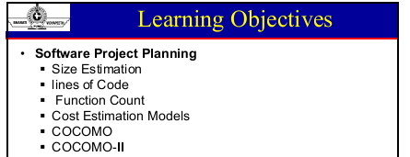

Slide 3
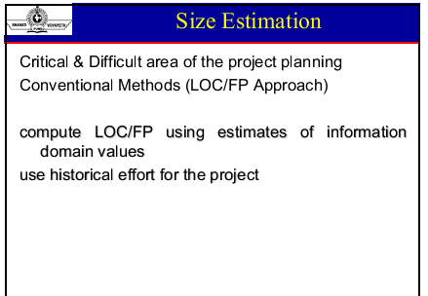

Slide 4
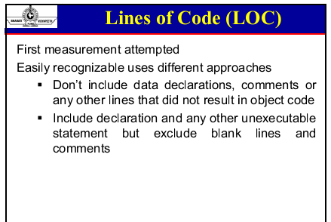

Slide 5
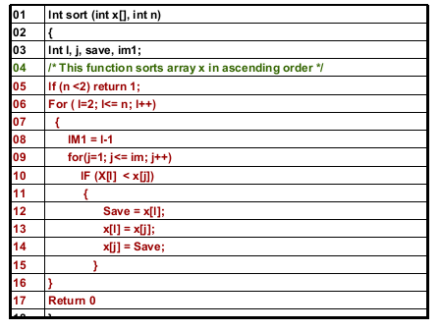
Example

Slide 6
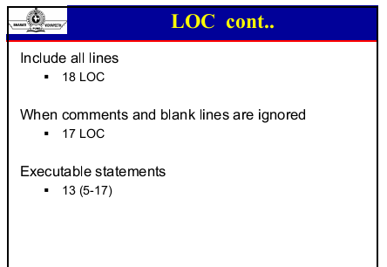

Slide 7
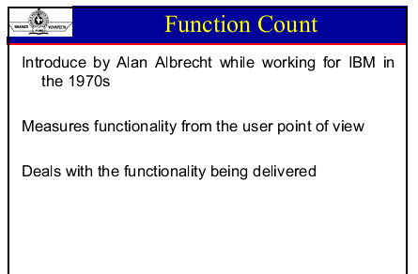

Slide 8
Function Points ( FP )
The approach is to identify and count a number of unique function types:
external inputs (e.g. file names)
external outputs (e.g. reports, messages)
queries (interactive inputs needing a response)
external files or interfaces (files shared with other software systems)
internal files (invisible outside the system)

Slide 9
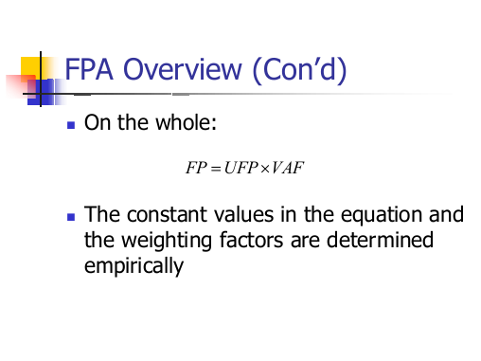

Slide 10
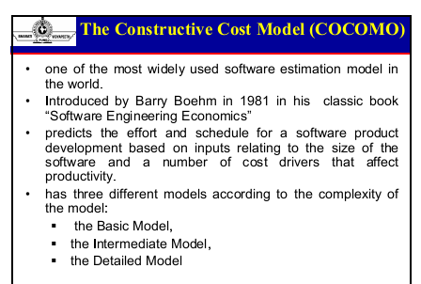

Slide 11
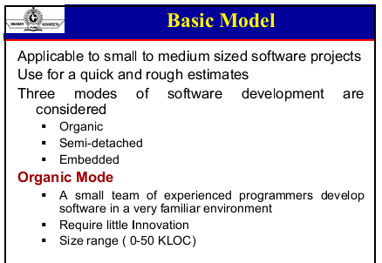

Slide 12
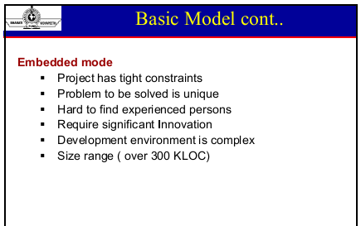

Slide 13
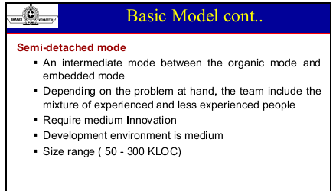

Slide 14
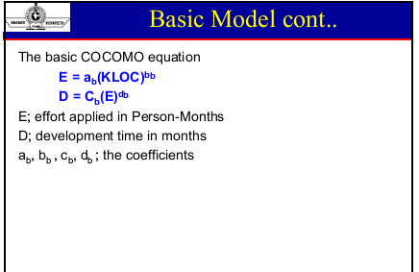

Slide 15
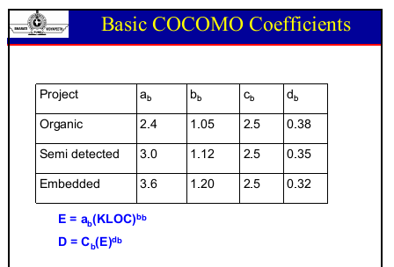

Slide 16
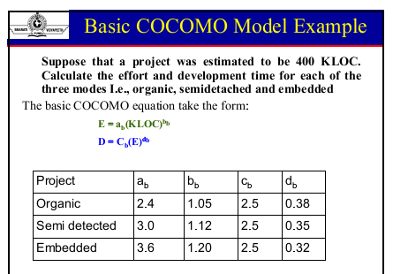

Slide 17
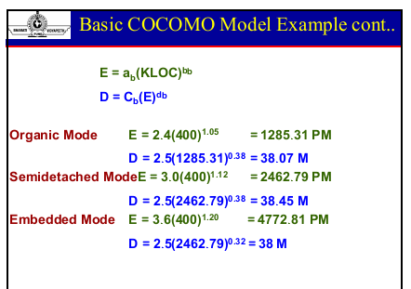

Slide 18
